Slide 1
Quadripartite activity brief overview and road to UNGA 2024
Danilo Lo Fo Wong
Regional Adviser – Control of Antimicrobial Resistance
WHO Regional Office for Europe
Cross=Sectoral One Health Conference on Antimicrobial resistance, Riga, Latvia, 7 December 2023

Slide 2
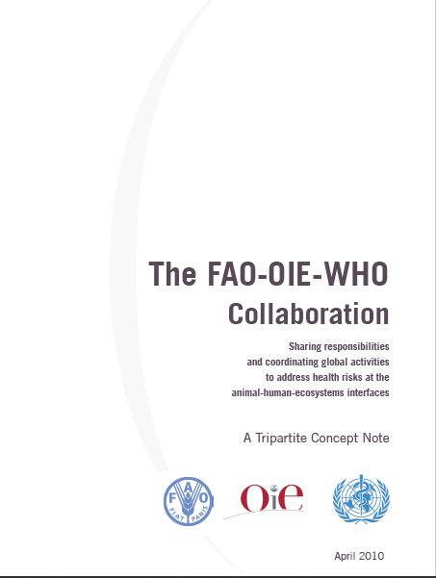
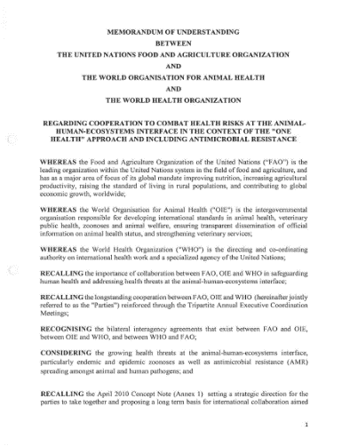
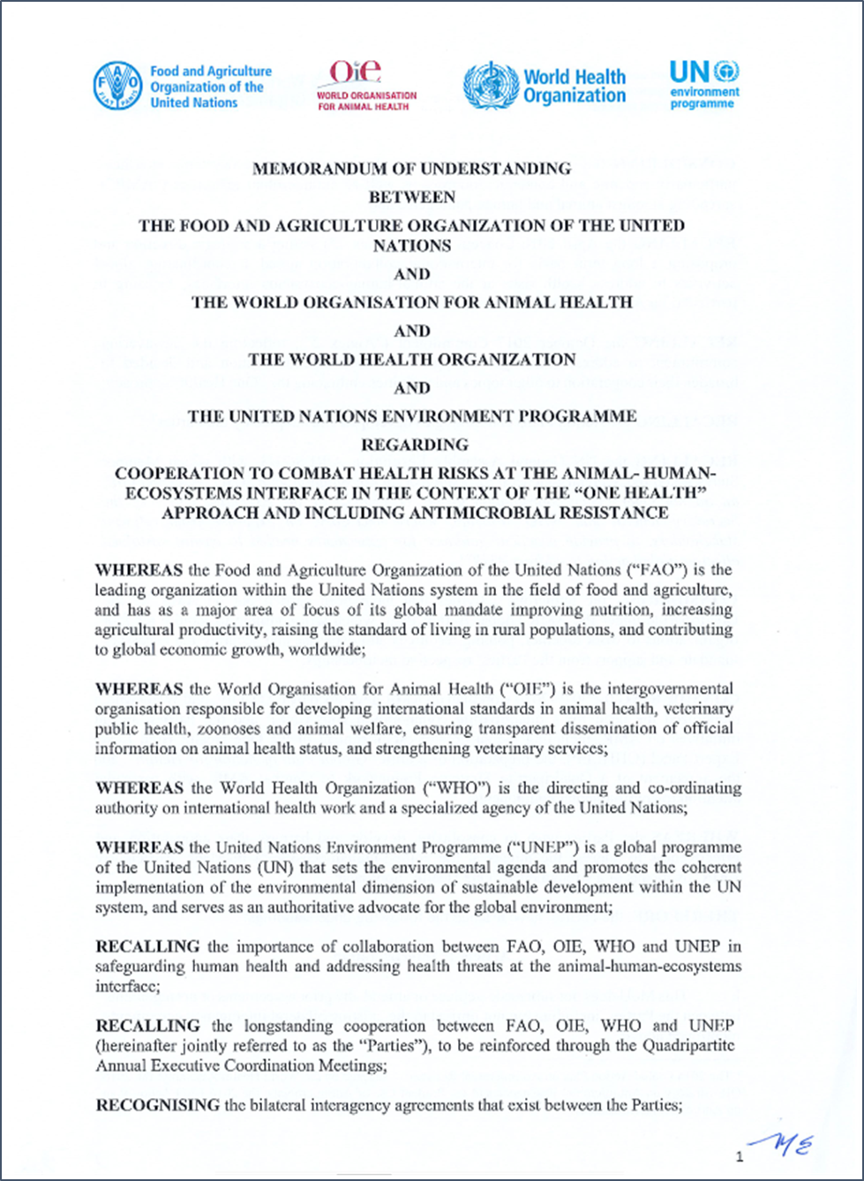
Tripartite Concept Note
April 2010
Tripartite MoU
May 2018
Quadripartite
March 2022
Quadripartite Coordination
At global level
QPT Secretariat
QPT Senior Management
QPT Annual Executive Meeting
At regional level
QPT Regional coordination
To consolidate, develop and harness the cooperation and effectiveness to address the threats at the human-animal-plant-ecosystem interface, particularly preventing further zoonotic pandemics and AMR, by means of a strengthened "One Health" approach.

Slide 3
One Health Joint Plan of Action (2022-2026)

Slide 4
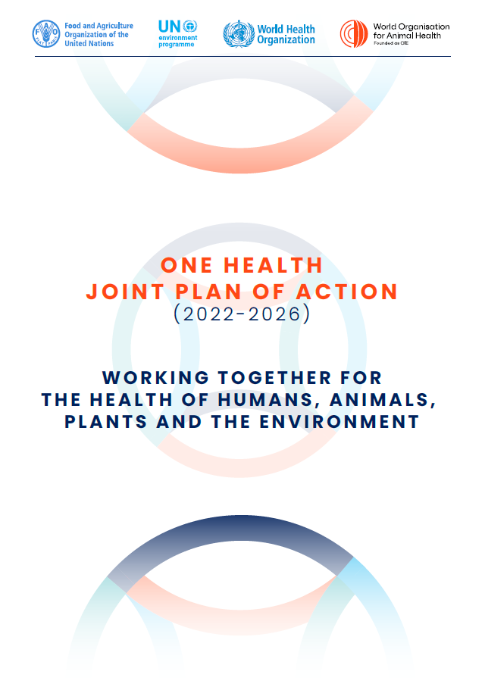
One Health Joint Plan of Action (2022-2026)
“Working together for the health of humans, animals, plants and the environment”
Actions and activities for the Quadripartite to advance One Health at all levels
Tools, guidance and support mechanisms that countries, partners and non-state actors can draw upon for their One Health planning and implementation
https://www.who.int/publications/i/item/9789240059139

Slide 5
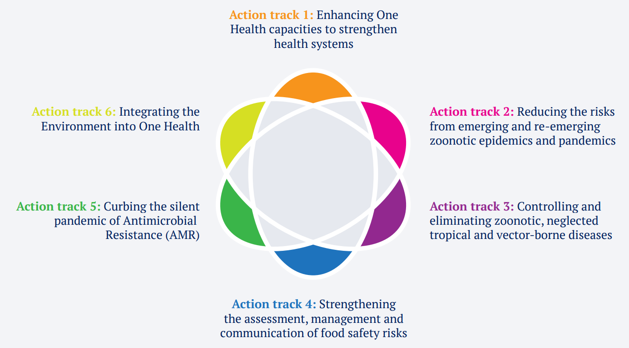
One Health Joint Plan of Action
SIX ACTION TRACKS

Slide 6
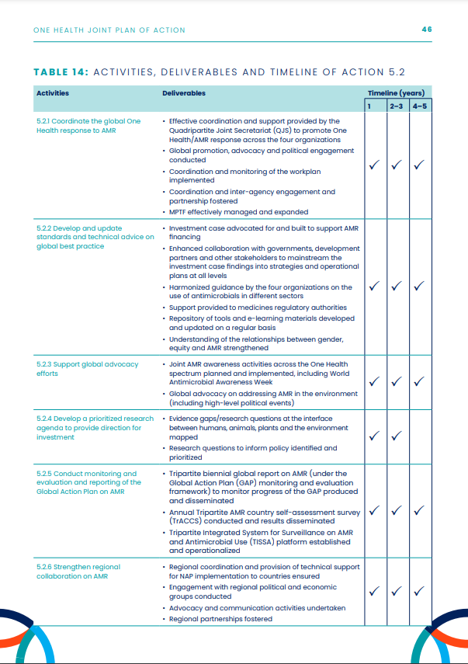
Example of activities, deliverables and timeline – AMR action track
Action 5.1. Strengthen the capacity and knowledge of countries to prioritize and implement context-specific collaborative One Health work to control AMR in policy, legislation and practice.
Action 5.2. Reinforce global and regional initiatives and programmes to influence and support One Health responses to AMR
Action 5.3. Strengthen global AMR governance structures.

Slide 7
A Guide to implementing the One Health Joint Plan of Action at national level

Slide 8
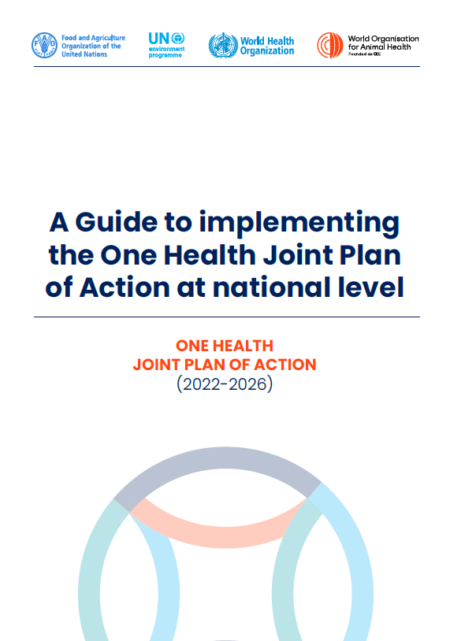
Purpose and Scope
The Guide provides practical guidance on how countries can adopt the OH JPA to strengthen and support national One Health action.
The Guide has an inclusive scope to allow each country to use it, regardless of its status on One Health development and implementation.

Slide 9
Target audience includes stakeholder groups relevant to the health of humans, animals, plants and the environment
National authorities
including but not limited to the human, animal, plant and environment sectors
Primarily responsible for One Health implementation
Other governmental and non-governmental stakeholders
Collaborators in One Health implementation at regional, sub-regional, national, and sub-national levels
Quadripartite organizations at all levels and their international collaborators
Supportive roles in One Health implementation

Slide 10
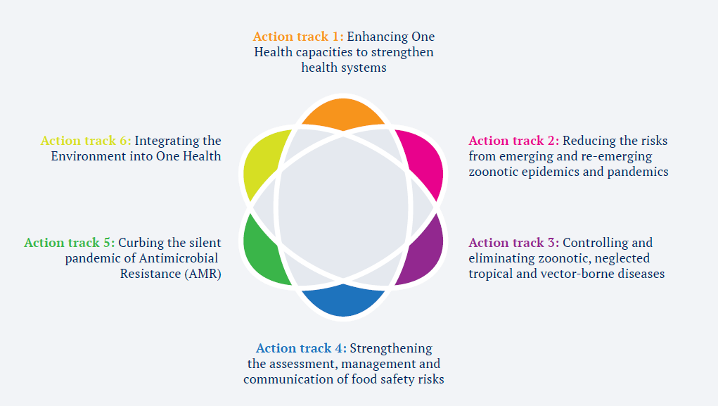
Basis of the Guide: Three pathways of change

Slide 11
Guiding Principles for OH JPA implementation
Applicable for any country to use
Flexible to respond to country needs
Aligned with OH JPA and building on existing work
Based on a stepwise approach to bring initiatives to scale
Evidence-based and informed decision-making
Based on principles of equity, parity and transdisciplin-
arity
Clarifies responsibilities for stakeholders
Aimed at measuring progress and scalability of the OH JPA

Slide 12
Stages to operationalize the OH JPA
3
5 Steps to OH JPA Implementation

Slide 13
Regional Quadripartite coordination and activities

Slide 14
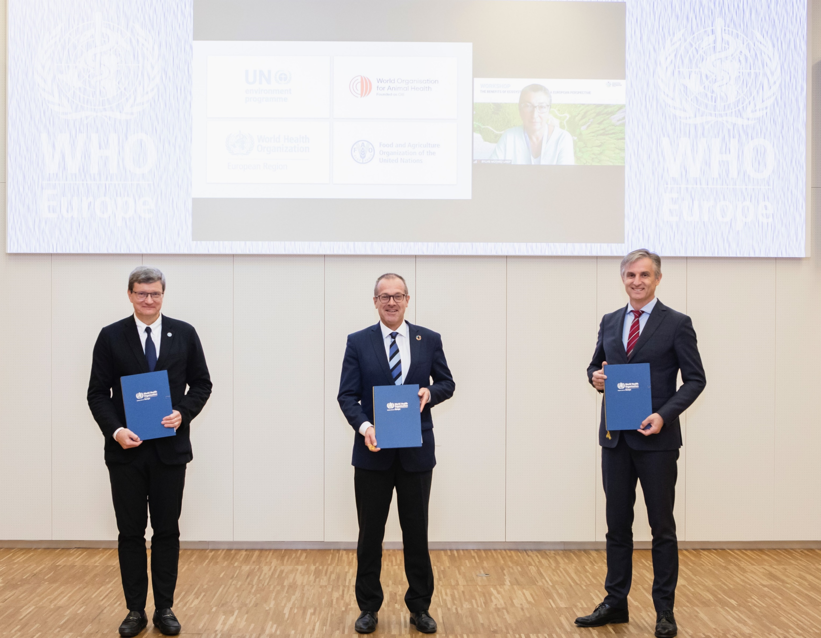
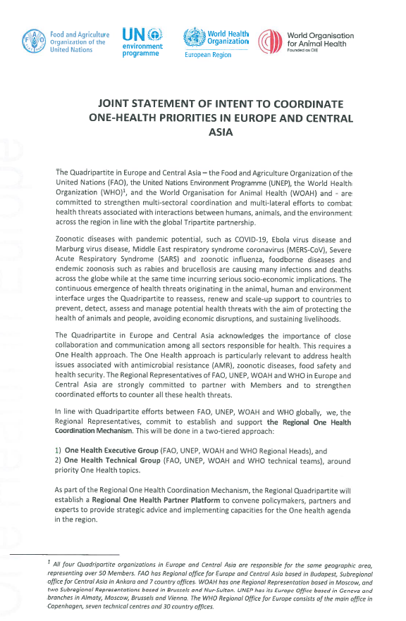
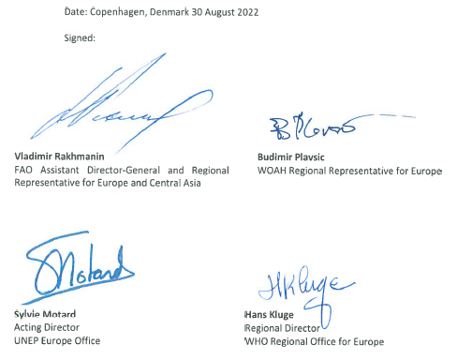
Regional One Health Coordination Mechanism for Europe and Central Asia (OHCM)

Slide 15
Regional One Health Coordination Mechanism for Europe and Central Asia (OHCM)
Strategic leadership
Identification of common priorities
Coordination of efforts
Planning joint activities
Monitoring progress

Slide 16
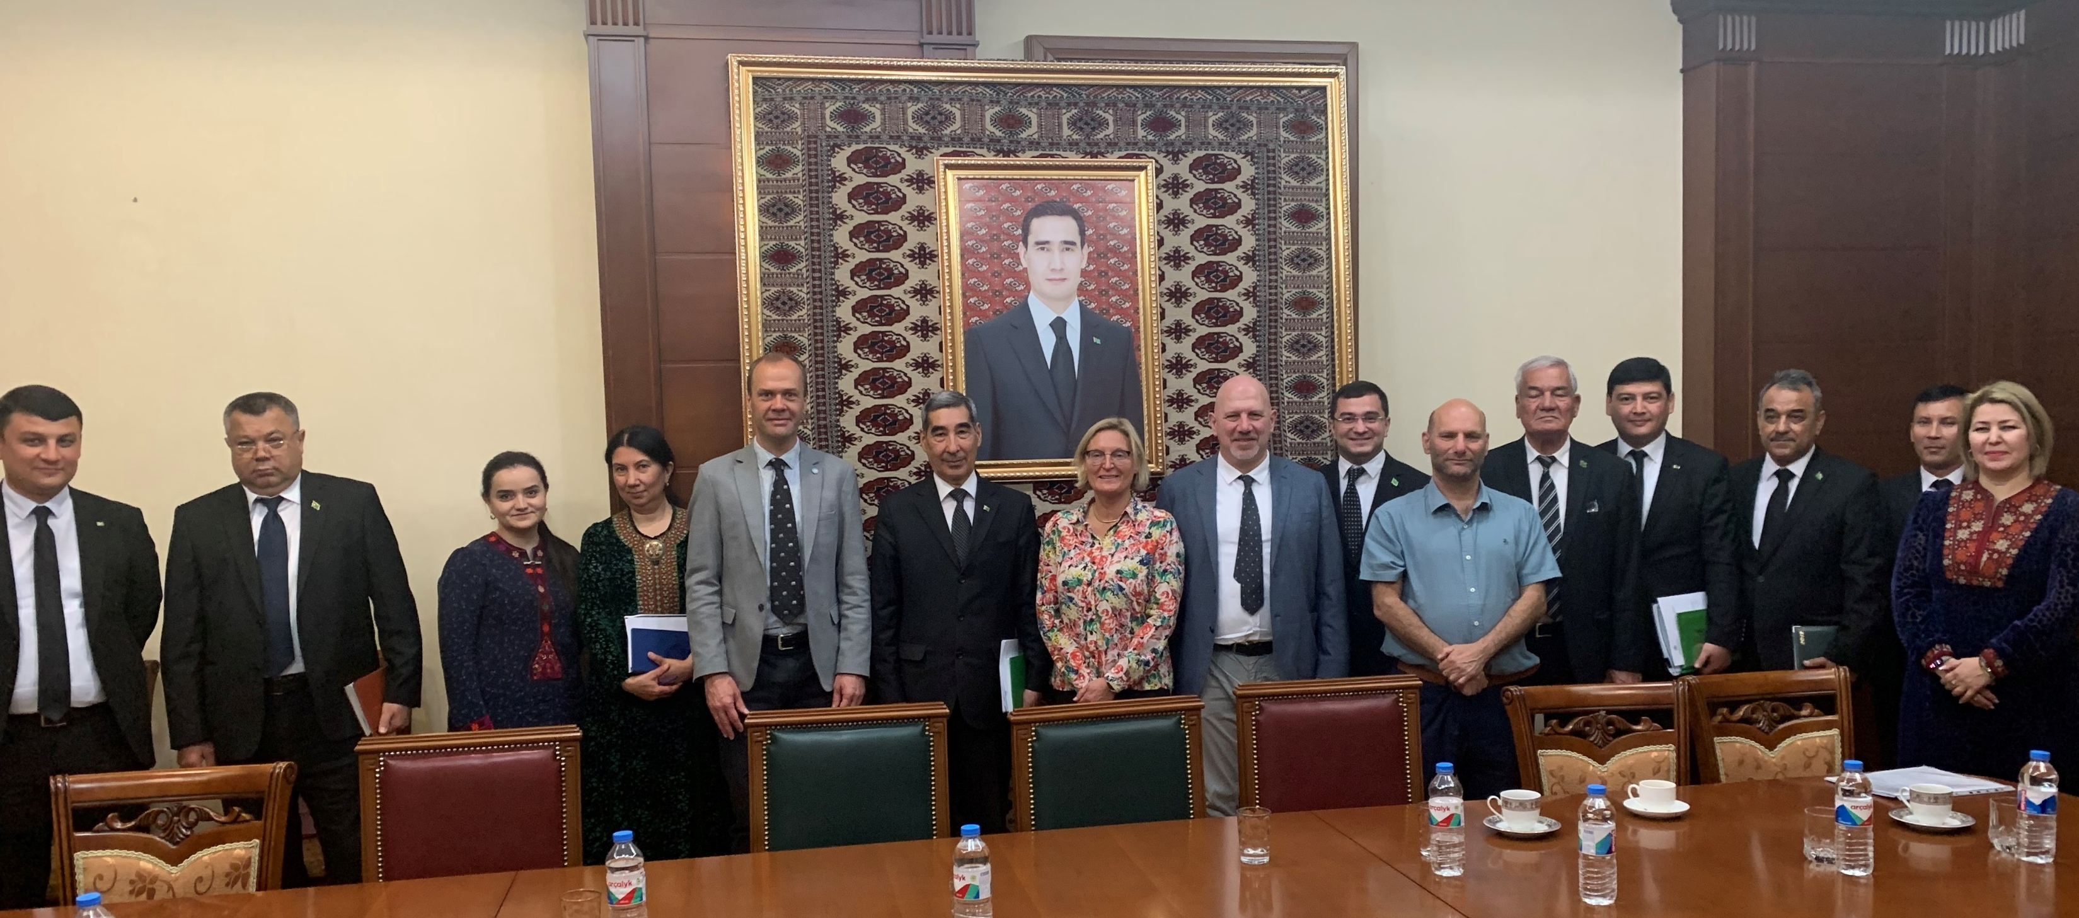
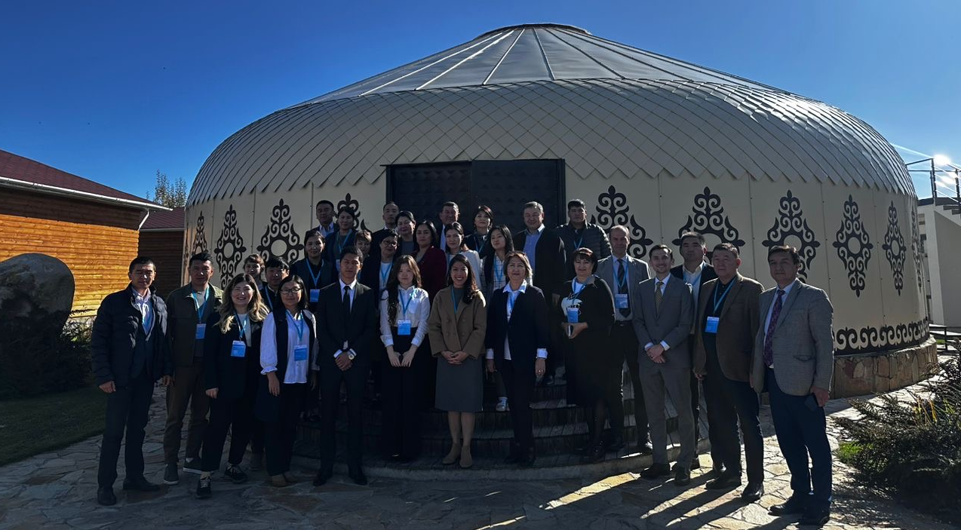
Selected examples of quadripartite joint work
Practical guidance on applying the One Health approach to address foodborne and zoonotic diseases: Workshop for the Western Balkans
Development of operational frameworks to address zoonotic disease outbreaks: In-country technical support in Albania, Croatia, Georgia, Kosovo* and Serbia
Strengthening capacity for joint risk assessment of priority zoonotic diseases in Ukraine
Strengthening multisectoral coordination to address zoonotic diseases: Establishing and strengthening multisectoral coordination mechanisms in Kazakhstan, Kyrgyzstan, Armenia and Azerbaijan
Joint activities to combat AMR: Country specific activities and regional campaigns and awareness raising
Joint country missions to provide recommendations for operationalizing the One Health approach
Joint technical mission on One Health to Turkmenistan, May 2023
Workshop to strengthen multi-sectoral One Health coordination in Kyrgyzstan, Oct 2023

Slide 17
The road to the United Nations General Assembly 2024

Slide 18
Health related UN General Assembly High Level meetings
‘Major events to engage more strongly heads of state and government to galvanise political efforts and pursue increased support, particularly financial’ Rodi et al, 2022
‘’We, Heads of State and Government and representatives of States and Governments, assembled at UN HQ in New York on…..’’

Slide 19
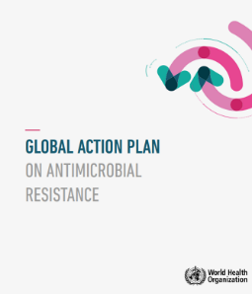
The UNGA 2016 Political Declaration was a major milestone for increased political action
2014
The 1st Ministerial Conference on AMR
2015
2016
2017
2019
2022
Global Action Plan on AMR adopted at the World Health Assembly
UN General Assembly Political Declaration September in 2016
OIE and FAO governing bodies endorsed Global Action Plan
Interagency Coordination Group (IACG) on AMR was established
The IACG launched its report with recommendations, April 2019
Quadripartite Joint Secretariat (QJS) established and hosted by WHO
Political declaration on UHC calls for a UNGA High level dialogue on IACG recommendations
2nd Ministerial Conference on AMR
UNEP joins FAO, WHO and WOAH to form the Quadripartite
3rd Ministerial Conference on AMR
Multi-stakeholder Partnership Platform launched
2024
2018
UN General Assembly High-Level Meeting
WHO, FAO and OIE sign an MoU to strengthen their long-standing partnership, with a strong focus on AMR in a One Health context
2020
2021
2023
AMR-GLG established
April 29, high-level dialogue on AMR and the call to action
October, co-facilitator announced – Barbados & Malta

Slide 20
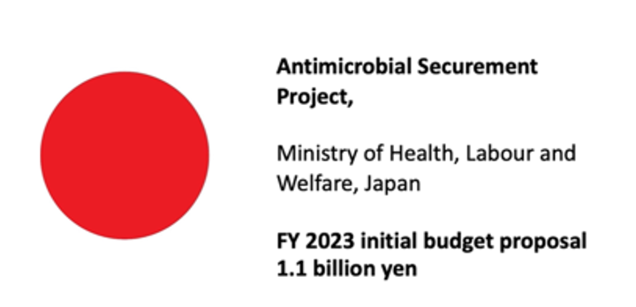
The UNGA 2016 Political Declaration was a major milestone for enhanced private-public-partnership
2016
2019
UN General Assembly Political Declaration September in 2016
2017
2018
2024
UN General Assembly High-Level Meeting
2020
2021
2022
2023

Slide 21
Lessons learned from the 2016 political declaration
Commitments | Specific actionable language included | Specific stakeholders mentioned | Primary accountable stakeholder | Overall progress
1. Countries to develop NAPs based on GAP |  |  | 
2. Support development and implementation of NAPs |  |  | x
3. Mobilize adequate, predictable and sustainable funding | x | x | x
4. Surveillance, monitoring and regulatory frameworks | x | x | x
5. Awareness and behavioral change | x | x | x
6. Multisectoral One Health approach | x | x | x
7. Global Development Stewardship Framework | x |  | 
8. Establish the Interagency Coordination Group (IACG) |  |  | 
Commitments with specific actionable language and primary accountable stakeholder have higher chance of implementation after the political declaration.

Slide 22
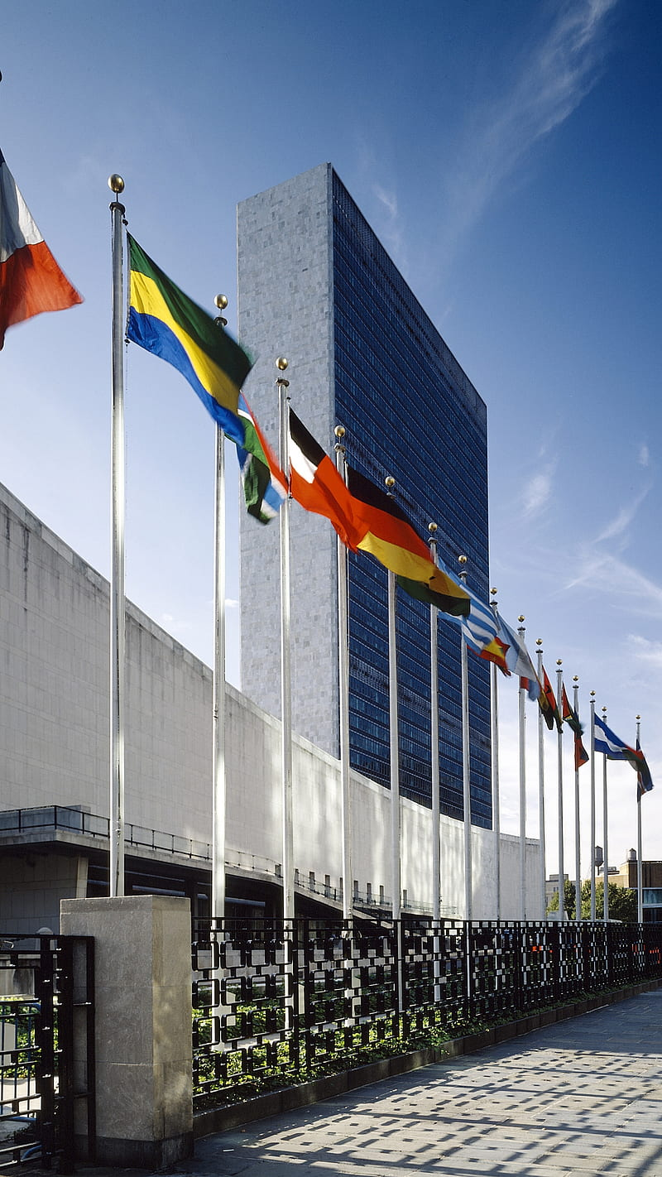
The AMR HLM 2024 will be transformational if
Lessons are drawn from the 2016 Political declaration and its implementation
Commitments are written with specific language and specific accountable stakeholder
Key areas of challenge are addressed
Targets (aspirational to galvanise action)
Financing (external and domestic)
Accountability (global and national)
The global AMR community unifies its voice and overcomes geopolitics differences

Slide 23
2nd TAG meeting Updates from WHO Secretariat
Thank you for your attention

Slide 24
Notes:
.

Slide 27
Situation analysis completed
National multisectoral, One Health coordination mechanism established or adapted
National One Health action plan developed with prioritized activities and stakeholder group(s) identified
MEL framework developed, with activities costed and resources mobilized

Slide 28
One Health International conferences
MEL
Pathway 2
Pathway 3
Pathway 1
National and Regional Stakeholder workshops
Regional One Health coordination mechanisms

